Slide 1
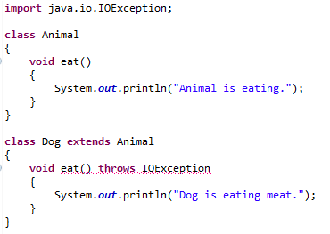
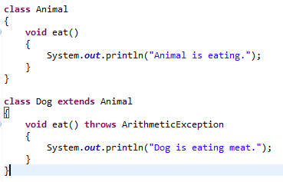


Exception Handling with Method Overriding
If the superclass method does not declare an exception:
If the superclass method does not declare an exception, subclass overridden method cannot declare the checked exception but it can declare unchecked exception.

